Slide 1
Technical communication (TC) 技术传播与写作
E-mail writing

Slide 2
Warm-up (Q&A)
Brainstorming:
Have you ever sent E-mails to your supervisors or lab mates?
Do you have some tips for E-mail writing to the new comers to your lab?

Slide 3
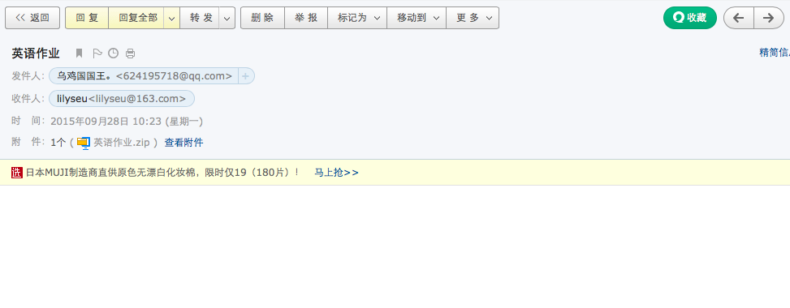
E-mail 1:comments?

Slide 4
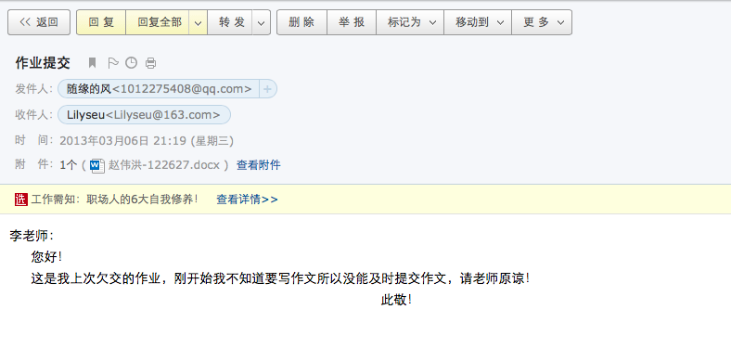
E-mail 2: comments?

Slide 5
Task 1
Scenario:
Lily is your new teacher who will take your class in the 3rd week. Please write an email to let her know the time and classroom.

Slide 6
Sample e-mail
Dear Lily,
This is Zhang San, monitor of class *, writing to let you know /remind you that tomorrow’s class will be 9:30-11:30 in rm 306, Jizhong Building. Please feel free /don’t hesitate to contact me if you have any questions. See you then.
Yours,
San

Slide 7
Task 2: comments?
The writer is a technical professional working for a microchip manufacturer.
To: Supers and Leads
Subject:
LATELY, WE HAVE BEEN MISSING LASER REPAIR FILES FOR OUR 16MEG WAFERS. AFTER BRIEF INVESTIGATION, I HAVE FOUND THE MAIN REASON FOR THE MISSING DATA.
OCCASIONALLY, SOME OF YOU HAVE WRONGLY PROBED THE WAFERS UNDER THE CORRELATED STEP AND THE DATA IS THEN COPIED INTO THE NONPROD STEP USING THE QTR PROGRAM THIS IS REALLY STUPID. WHEN DATE IS COPIED THIS WAY THE REPAIR DATA IS NOT COPIED. IT REMAINS UNDER THE CORRELATE STEP.
TO AVOID THE PROBLEM, FIRST PROBE THE WAFFERS THE RIGHT WAY. IF A WAFFER MUST BE PROBED UNDER A DIFFERENT STEP, THE WAFFER IN THE CHANGE FILE MUST BE RENAMED TO THE **FORMAT.

Slide 8
EDITTING THE WAFFER DATA FILE SHOULD BE USED ONLY AS A LAST REPORT, IF THIS BECOMES A COMMON PROBLEM, WE COULD HAVE MORE PROBLESM WITH INVALID DATA THAT THERE ARE NOW.
SUPERS AND LEADS: PLEASE PASS THIS INFORMATION ALONG TO THOSE WHO NEED TO KNOW.
ROGER VANDENHEUVAL.

Slide 9
Task 2 comments
No subject
To: Supers and Leads
Subject:
LATELY, WE HAVE BEEN MISSING LASER REPAIR FILES FOR OUR 16MEG WAFERS. AFTER BRIEF INVESTIGATION, I HAVE FOUND THE MAIN REASON FOR THE MISSING DATA.
OCCASIONALLY, SOME OF YOU HAVE WRONGLY PROBED THE WAFERS UNDER THE CORRELATED STEP AND THE DATA IS THEN COPIED INTO THE NONPROD STEP USING THE QTR PROGRAM THIS IS REALLY STUPID. WHEN DATE IS COPIED THIS WAY THE REPAIR DATA IS NOT COPIED. IT REMAINS UNDER THE CORRELATE STEP.
TO AVOID THE PROBLEM, FIRST PROBE THE WAFFERS THE RIGHT WAY. IF A WAFFER MUST BE PROBED UNDER A DIFFERENT STEP, THE WAFFER IN THE CHANGE FILE MUST BE RENAMED TO THE **FORMAT.
No purpose
Upper case=yelling
Hostile tone
No proofreading
Long lines and no space between paras

Slide 10
EDITTING THE WAFFER DATA FILE SHOULD BE USED ONLY AS A LAST REPORT, IF THIS BECOMES A COMMON PROBLEM, WE COULD HAVE MORE PROBLESM WITH INVALID DATA THAT THERE ARE NOW.
SUPERS AND LEADS: PLEASE PASS THIS INFORMATION ALONG TO THOSE WHO NEED TO KNOW.
ROGER VANDENHEUVAL.
No proofreading

Slide 11
Netiquette guidelines for writing a business email
Netiquette refers to etiquette on a network.
Stick to business
Use appropriate formality
Write correctly
Don’t flame
Make your message easy on the eyes
Don’t forward a message to an online discussion forum without the writer’s permission
Don’t send a message unless you have something to say

Slide 12
Use appropriate formality --use a moderately formal tone
Get worse
Too informal
Our meeting with United went south right away when they threw a hissy fit, saying that we blew off the deadline for the progress report.
Moderately formal
In our meeting, the United representative expressed concern that we had missed the deadline for the progress report.
miss
Make a fuss

Slide 13
Use appropriate formality --use a moderately formal tone
undoubtedly
Too formal
It was indubitably the case that our team was successful in presenting a proposal that was characterized by quality of the highest order. My appreciation for your industriousness is herewith extended.
Task 3: rewrite the above into moderately formal tone
I think we put together an excellent proposal. Thank you very much for your hard work.

Slide 14
Task 4: rewrite the E-mail in task 2
To: Supers and Leads
Subject: Fix for Missing Laser Repair Files for 16MB Wafers
Supers and Leads (Dear Dave and Alice):
Lately, we have been missing laser repair files for our 16MB wafers. In this e-mail I ‘d like to briefly describe the problem and recommend a method for solving it.
Here is what I think is happening. Some of the wafers have been probed under the correlate step; this method copies the data into the nonprod step and leaves the repair data uncopied. It remains under the correlate step.
subject/purpose
Double spacing /short lines

Slide 15
To prevent this problem, please use the probing method outlined in Spec 344-012. If a wafer must be probed using a differentmethod, rename the wafer in the CHANGE file to the *.* format. Edit the wafer data file only as a last resort.
I'm sending along copies of Spec 344-012. Would you please pass along this e-mail and the spec to all of your operators?
Thanks. Please get in touch with me if you have any questions.
Best,
Roger Vandenheuval
Concludes politely

